Slide 1
Project 2 -Group 6
EL NINO
Vu Pham, Kwabena Baffour, Alex Lopez

Slide 2
Background
El Niño is a climate pattern that describes the unusual warming of surface waters in the eastern tropical Pacific Ocean.These events occur irregularly at two- to seven-year intervals
El Niño has an impact on ocean temperatures, the speed and strength of ocean currents, the health of coastal fisheries, and local weather from Australia to South America and beyond.
El Niño events are defined by their wide-ranging teleconnections. Teleconnections are large-scale, long-lasting climate anomalies or patterns that are related to each other and can affect much of the globe
Events of 1982-83 and 1997-98 were the most intense of the 20th century. During the 1982-83 event, sea surface temperatures in the eastern tropical Pacific were 9-18° F above normal.
The 1997-98 event produced drought conditions in Indonesia, Malaysia, and the Philippines. In the United States, increased winter rainfall hit California, while the Midwest experienced record-breaking warm temperatures during a period known as “the year without a winter.”
https://www.nationalgeographic.org/encyclopedia/el-nino/

Slide 3
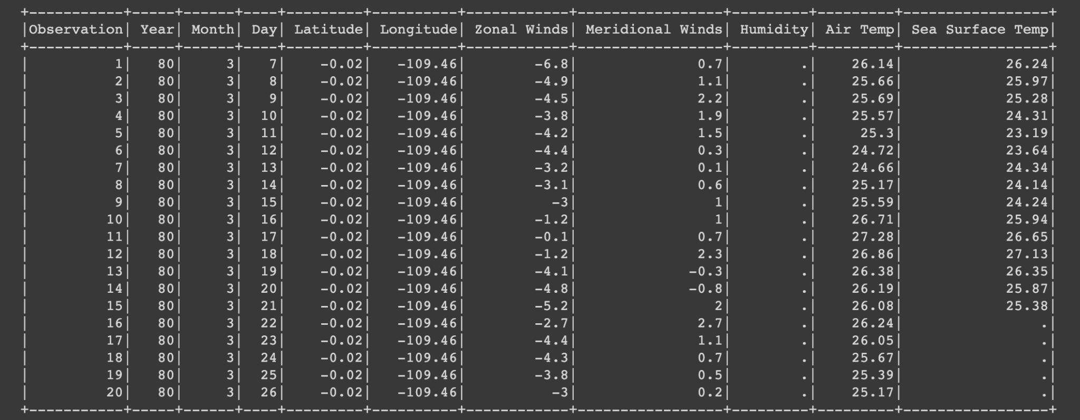
Dataset
Kaggle
178,xx0 Entries

Slide 4
Dataset clean up
Drop the Date column
Fill up the N/A Values
Two fill Methods
Using the mean
Using linear regression Prediction
Used linear regression prediction to model

Slide 5
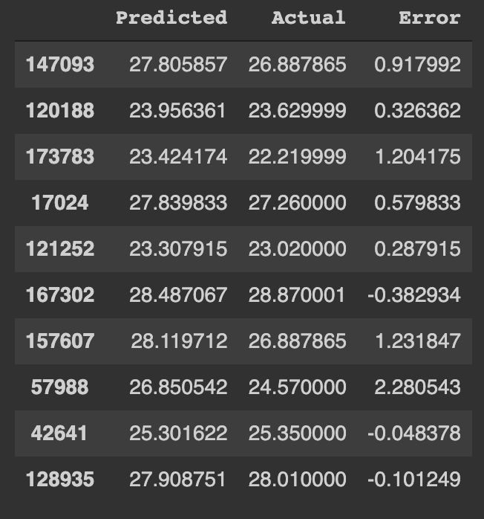
Analysis
Wanted to see how accurate we could predict the air temperature
78.7XX % prediction rate
Very high
Predicted values was very close to actual values
At most within +- 2.5 digits

Slide 6
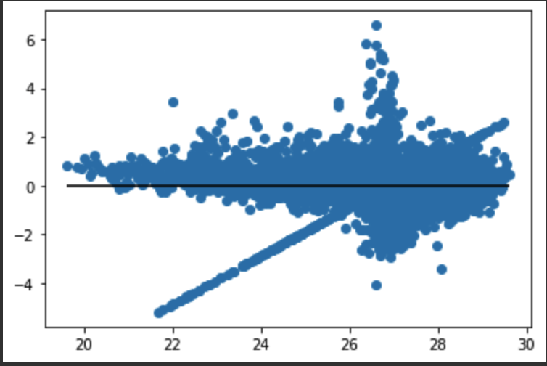
Analysis
Points were very condensed and showed an odd shape
We noticed that when either the air temp or Sea Surface temp were the dependent it gave a strong score.

Slide 7
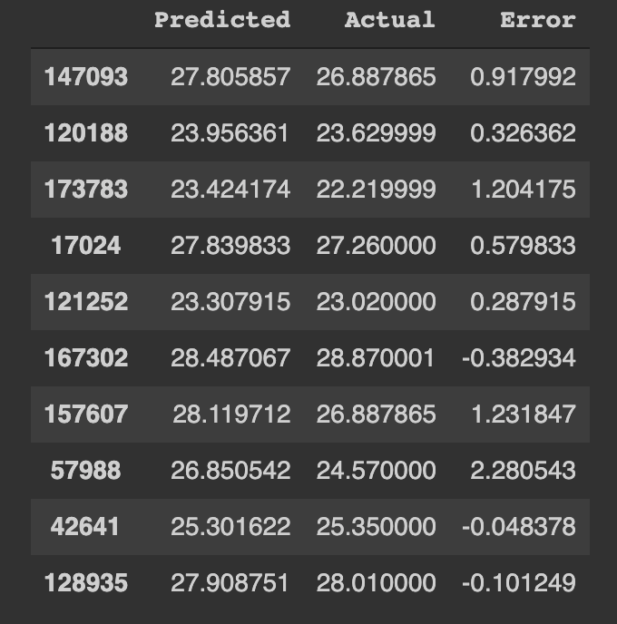
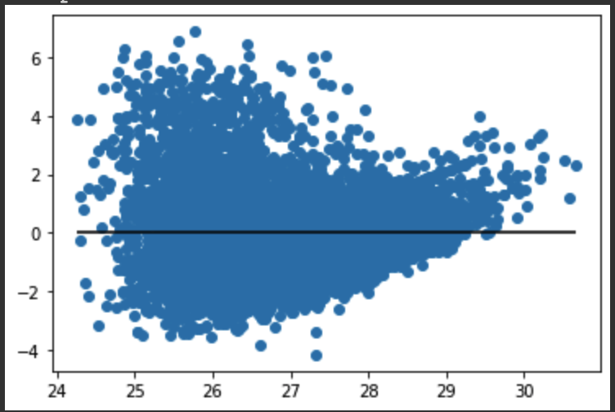
Analysis
Dropped sea surface temperature as an independent var
Score of 32.XX%
Huge difference in score
Error is now larger.

Slide 8
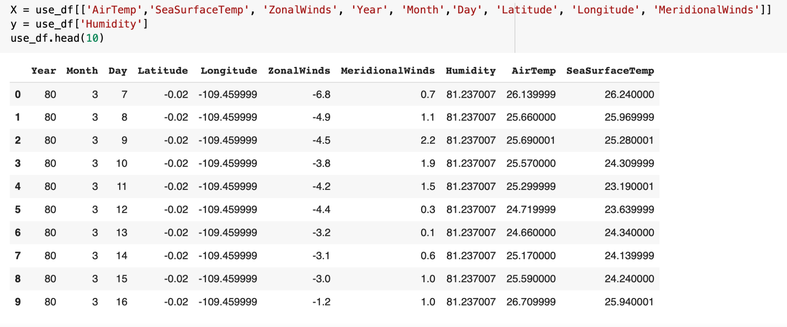
Analysis
Consideration of humidity as the dependent variable
Creation of a Linear Regression Model
The trained data were fit to the model
Prediction of approximately 13.36% made

Slide 9
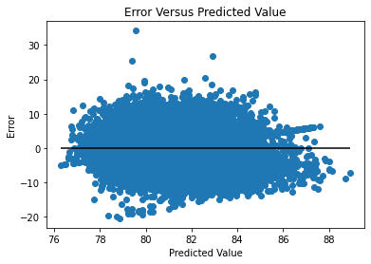
Analysis
Data points really spread out
Low precision due to separation between data points
Low accuracy due to deviation from the horizontal line

Slide 10
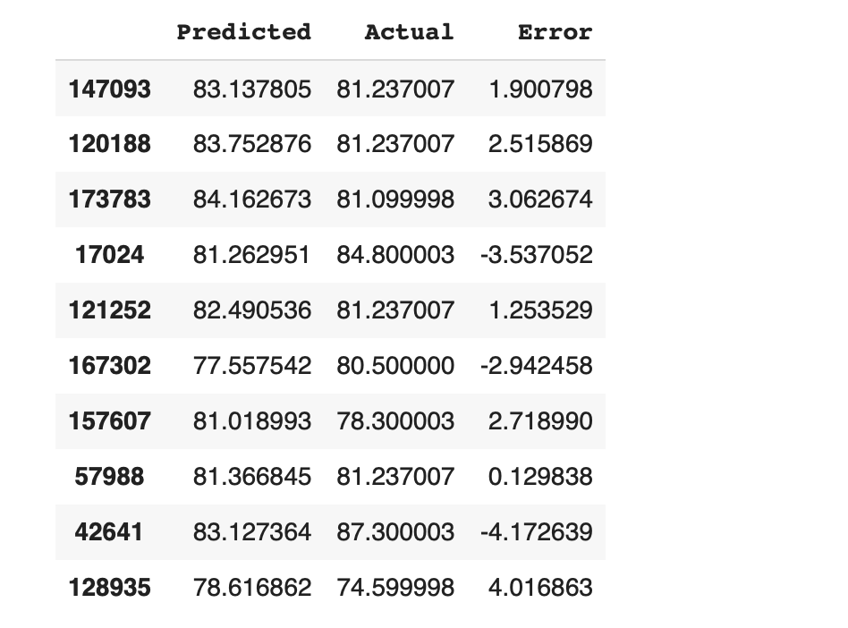
Analysis
Predicted values and their corresponding actual values showed a wide difference
The humidity variable has less effects on climate variations
Humidity alone is not the best prediction variable for weather conditions

Slide 11
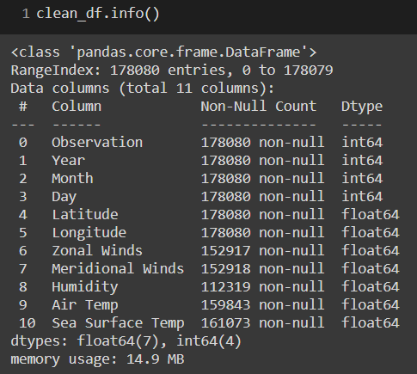
Fill up NA values
Data is missing in columns:
Zonal Winds
Meridional Winds
Humidity
Air Temp
Sea Surface Temp

Slide 12
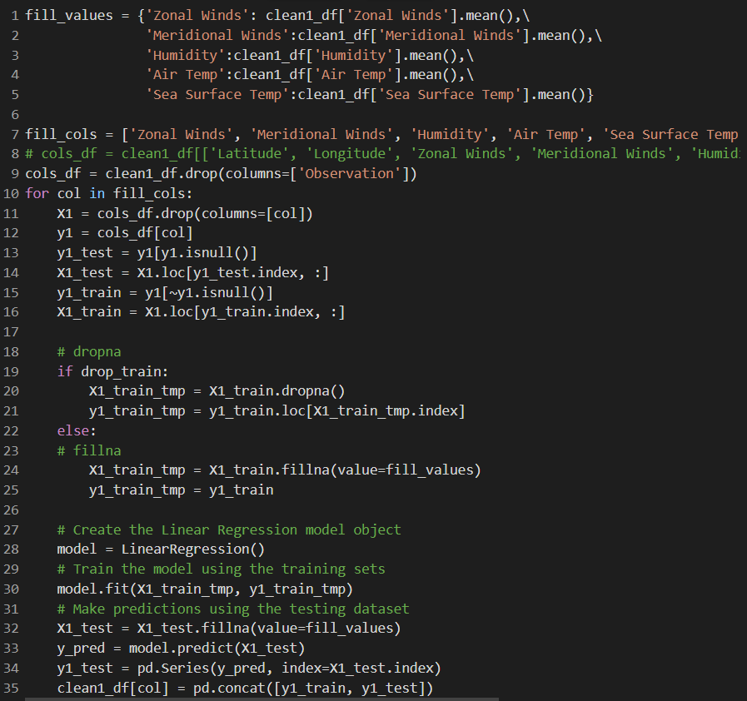
Fill up NA values using prediction
Slice target column into 2 sets of NA values and numeric values
Drop/fill train dataset
Fill up X_test NA values with column mean value
Predict missing values using LinearRegression model
Add predicted values into current dataframe

Slide 13
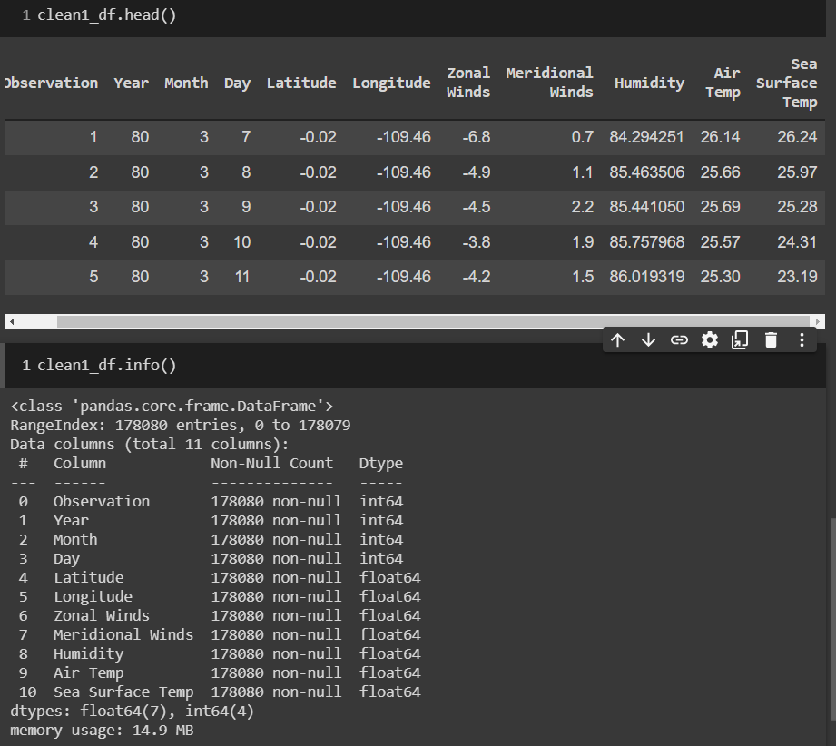
Fill up NA values using prediction

Slide 14
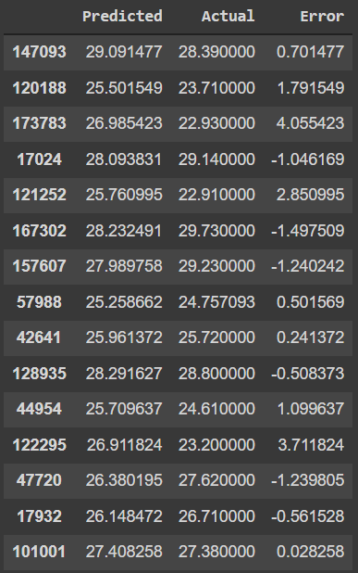
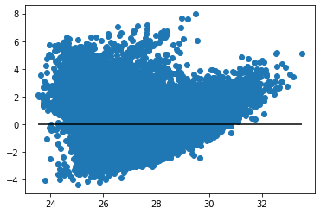
Analysis
Linear Regression result
R2 score:
Drop NA for training set: 0.4983
Fill up NA for training set: 0.5034
Improve more than 20% compared to method of filling by mean values
Error distribution spreads mostly in positive half of plot
Predicted ‘Sea Surface Temp’ using prediction filling method.

Slide 15
R2 score comparison
 | Drop NAs | Fill up with means | Fill up with prediction
Zonal Winds | 0.3408 | 0.2014 | 0.3882
Meridional Winds | 0.1644 | 0.1708 | 0.2236
Humidity | 0.2152 | 0.1365 | 0.3441
Air Temp | 0.3527 | 0.3268 | 0.4738
Sea Surface Temp | 0.3802 | 0.3690 | 0.4983

Slide 16
Conclusion
Using linear regression to fill N/As will yield better results
Humidity is not a good prediction variable
As compared to Air Temp and Sea Surface temp which are better prediction variable

